Slide 1



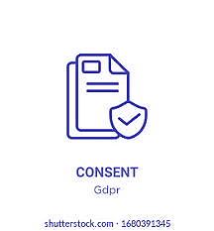
Application:
Personal Data:
Personal Data Breach:
Notice and Consent:
Governs processing of "digital personal data“
Excludes processing for personal or domestic purposes and data in records over 100 years old
Applies to processing of data outside India related to Indian Data Principals' profiles or provision of goods/services to them
All personal data falls under a single category
Classification of sensitive portions (biometric, healthcare data) allows gradual consent and penalties
Unauthorized processing, disclosure, acquisition, etc., compromising confidentiality, integrity, or availability
Notification requirement for data fiduciary/processor to inform the Board and affected data principals
"Deemed permission" for freely given personal information
Limited circumstances for presumed consent

Slide 2



Deemed Consent:
Rights of the Data Principal:
Cross-border Data Transfers:
Instances where permission is not expressly required
Public interest grounds for presumed consent defined by government regulation
No explicit inclusion of "legitimate interests" or "performance of a contract" justifications
Right to information on processing of personal data
Right to correction or erasure of personal data
Right of grievance redressal through data fiduciary and the Board
No requirements for local storage/localization
New restrictions on international data transfers, with government notification of recipient countries
Similar to GDPR's adequacy approach

